Slide 1
Amazon Web Services
Web Application Deployment

Slide 2
Pre-requisites
AWS Account with student credits
Sign up for Amazon Educate
Request student credits
https://www.awseducate.com/Application?apptype=student ; $35 in AWS credit
Or via
https://education.github.com/pack ~$75-100 free AWS credits
Working Travel Wishlist 2 Django app – the one with image uploads, delete button, trip reports

Slide 3



Cloud Service Providers
The cloud = someone else's computer(s)
Set up a web server, database server, storage... on one of your cloud provider's computers, instead of your own
Cloud computers are virtual machines, often Linux OS
Scalable, elastic, always on, rapid deployment, pay-as-you-go pricing
Removes the need for organizations to manage their own hardware
Economies of scale, delegate admin, maintenance, security etc. to cloud provider
Very, very popular

Slide 4
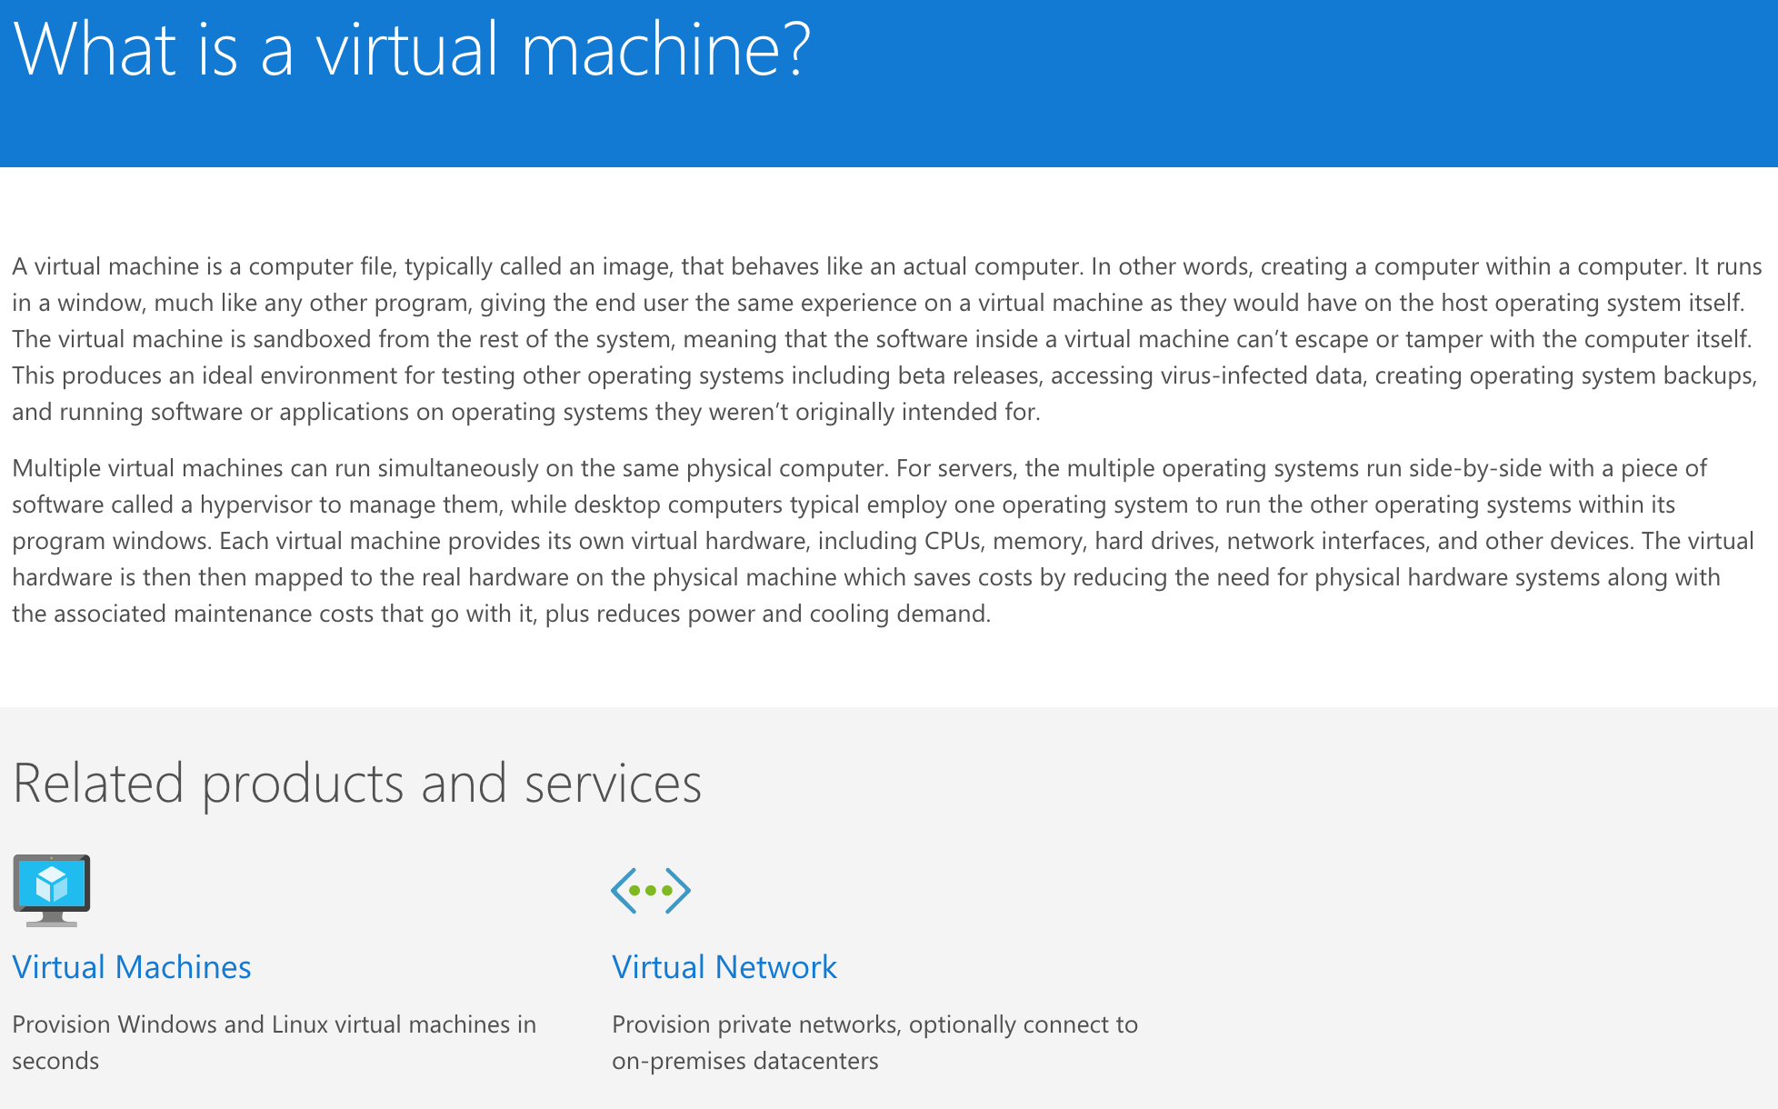
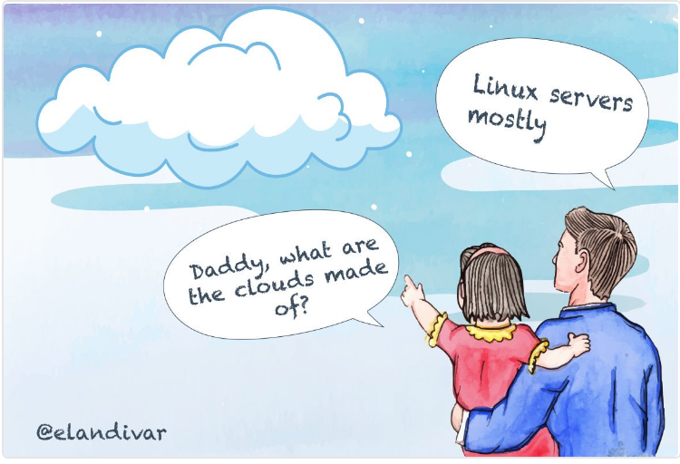
Even Microsoft's Azure uses Linux virtual machines!
https://azure.microsoft.com/en-us/overview/what-is-a-virtual-machine/

Slide 5
Qualities of Cloud Computing
Fast setup - no physical hardware to install and manage
No need to deal with upgrading hardware, patching, maintenance...
Economies of scale - cloud provider can operate 1000s of servers somewhere power is cheap, pass savings to customer https://www.google.com/about/datacenters/
Elastic, scalable
If demand is low, uses only resources needed. If demand increases, can automatically scale (add new virtual servers - instances - and balance load between them) to handle demand; remove/scale down when demand falls
What companies can you think of that don't have consistent requirements for infrastructure?
Billed using a pay-as-you-go model
Only pay for the resources being used
Projects are composed of services – separation of roles for a project
so one service for web server, one for database, one for API, one for static files, one for log reports, one for email, one for analytics…

Slide 6
The Cloud
The cloud = someone else's computer(s)
Which has pros and cons
Pros: cheaper, operational benefits, elasticity, scalability, no need to manage hardware, convenient web console access...
Cons: it's someone else's computer; all services can be accessed via browser interface
Essential to keep access credentials secure, have backups in another location
DO NOT UPLOAD CREDENTIALS OR KEYS OR PASSWORDS TO GITHUB
Ensure cloud provider has the ability to store data in compliance with any required regulations, PCI, HIPAA etc.
Various ways for malicious users to exploit cloud services: mining Bitcoin, changing your passwords and demanding a random for access...
https://adeliarisk.com/secure-cloud-computing-7-ways-id-hack-aws/

Slide 7

Cloud Service Providers
AWS (Amazon Web Services) is the market leader
Microsoft Azure, IBM Cloud and Google Cloud Platform have around 10-15% market share each, but are all growing

Slide 8
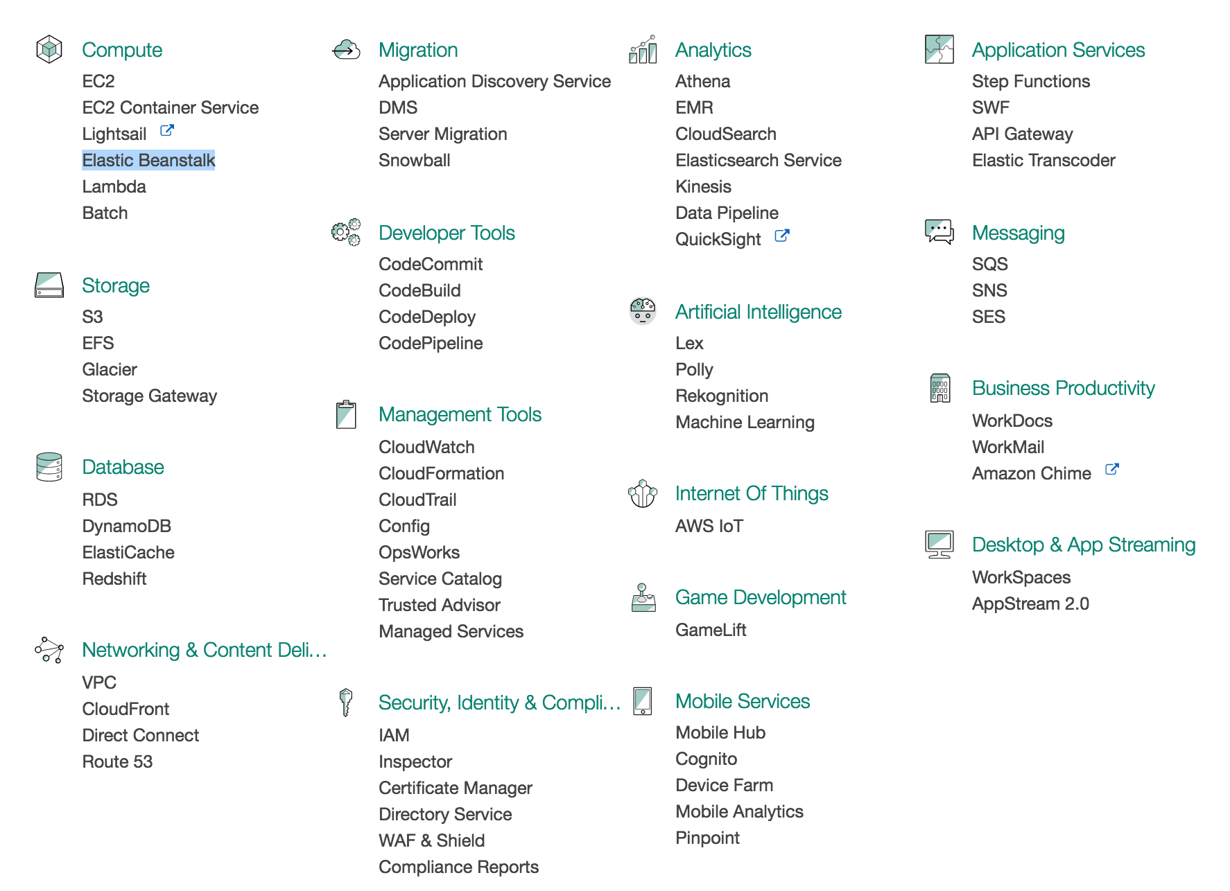
Amazon Web Services, AWS
AWS offers many types of services, storage, hosting, computing… can be overwhelming

Slide 9
We'll use
Elastic Beanstalk (EB): PaaS (Platform as a Service) to host a web application
RDS: relational database service, to host a PostgreSQL database
S3: simple storage service, for static files (CSS stylesheets, client-side JavaScript) and media (user uploaded images) storage

Slide 10
Elastic Beanstalk is a PaaS provider: Platform as a Service
Platform = the (virtual) server that will run your code
Provides a mostly configured virtual web server that you can upload your code to
Many other similar services; Heroku, Google App Engine, Azure Virtual Machines, Engine Yard...
Some minimal server configuration usually required
Heroku: very little or none, GAE and EB require more configuration

Slide 11
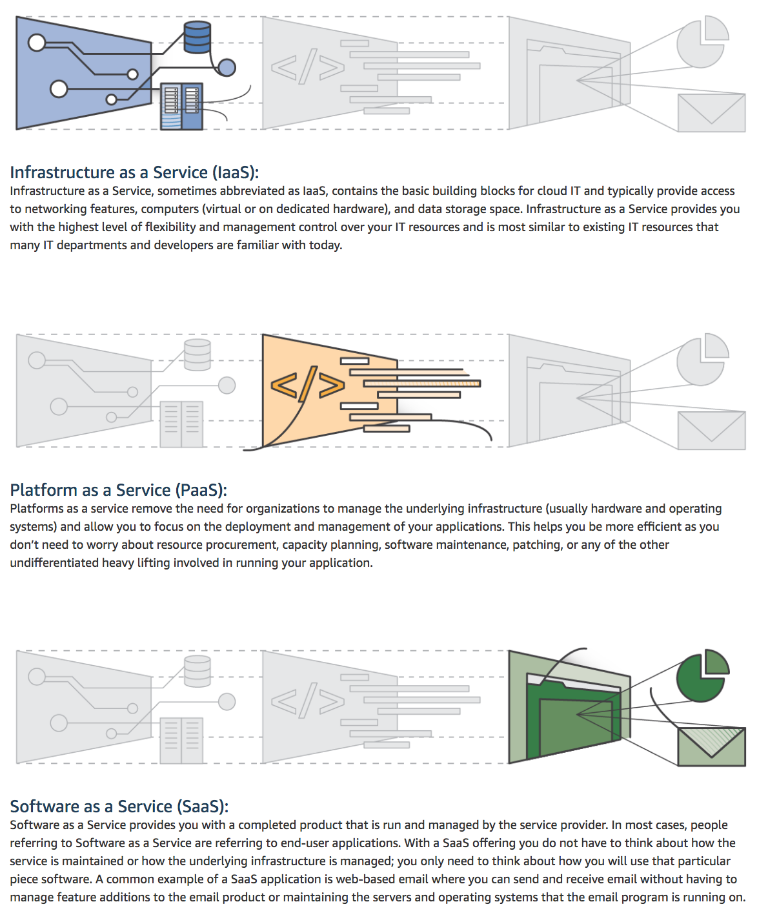
Type of Cloud Computing
There's overlap between these types
You can do some (or no) infrastructure configuration in App Engine and AWS Elastic Beanstalk
Heroku is a PaaS - minimal server configuration, but very fast deploy
IaaS, infrastructure as a service - a bare computer that you install and configure as a web server. More work but more flexible. AWS Elastic Beanstalk has some qualities of IaaS: you do some raw server configuration to get your app running.
https://aws.amazon.com/types-of-cloud-computing/

Slide 12
Deployment tool: eb
Will use the eb command line tool
This is linked to your AWS account
Manages creating a secure connection to AWS
Can be used to create applications
Works with git
Collects all the code from the latest commit, and sends it to AWS
Contains other management tools
Other services typically have their own tools e.g. Heroku CLI, gcloud for Google App Engine…

Slide 13
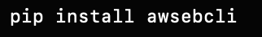
Install eb
Command line tool, used to send your code to AWS
Install using pip (or pip3 for Macs/Linux)
pip install awsebcli
awsebcli = Amazon Web Services Elastic Beanstalk Command Line Interface
Verify install by typing
eb --version

Slide 14
Amazon Console
https://aws.amazon.com/console/
Manage all of your AWS things

Slide 15
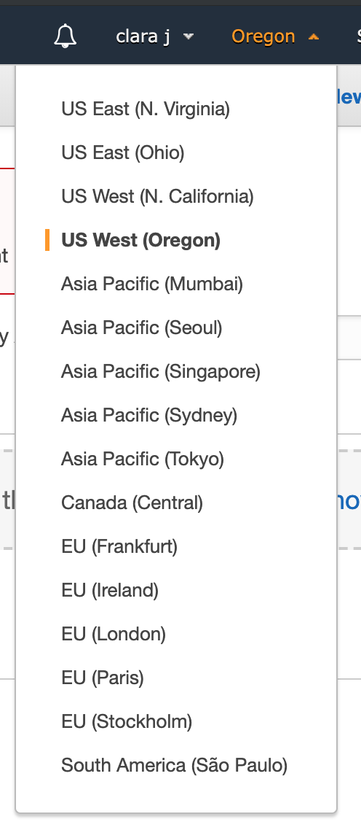
Regions
AWS has several locations around the world
These correspond to physical locations of data centers that Amazon operates
For most services, you select which region you wish to use
We'll use US-West-2, Oregon
The region that's geographically closest to your customers is usually cheapest and provides the fastest service
Ohio is closer in MN than Oregon but it's newer and as of spring 2019, is missing some of the features that Oregon has

Slide 16
Overview of deployment process
Create application
Add to git source control
Use eb to create an Elastic Beanstalk application
Use eb to create an environment in this application (this will run your code)
Set up production configuration files
Add and commit all code, config and resources to local git repo
Use eb to send committed code to AWS

Slide 17
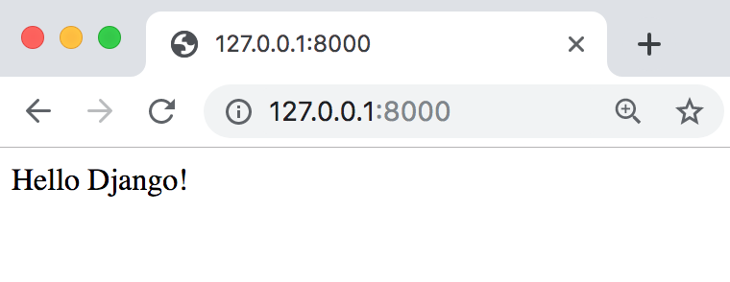
Very Basic App
Hello Django
Displays a home page with a message
No database used, no static files etc.
Code here, FORK TO YOUR GITHUB and clone: https://github.com/claraj/hello_django_aws
cd hello_django_aws
create a virtual environment; Python 3; activate
pip install -r requirements.txt
python manage.py runserver

Slide 18
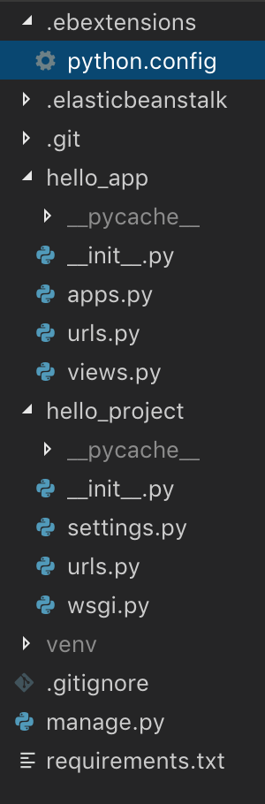
Configuration
Create a new directory called .ebextensions
in the root directory of your project
(This is the same place as requirements.txt and manage.py)
In .ebextensions create a file called python.config

Slide 19
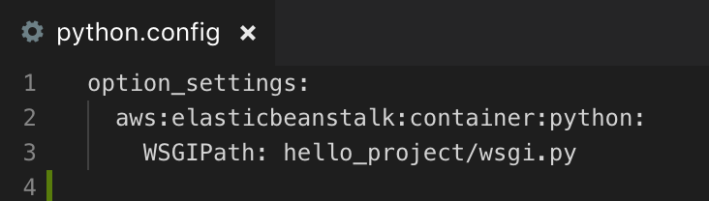
.ebextensions/python.config
.config files are formatted as YAML documents
The indentation matters
Use blocks of 2 spaces
This config file tells AWS which file to run to start the server

Slide 20
Add new file to git
Add and commit the new .ebextensions and python.config file
Commit

Slide 21
Create credentials
Create access keys for the eb tool to use
Needed to authenticate to AWS
https://console.aws.amazon.com/iam/home

Slide 22
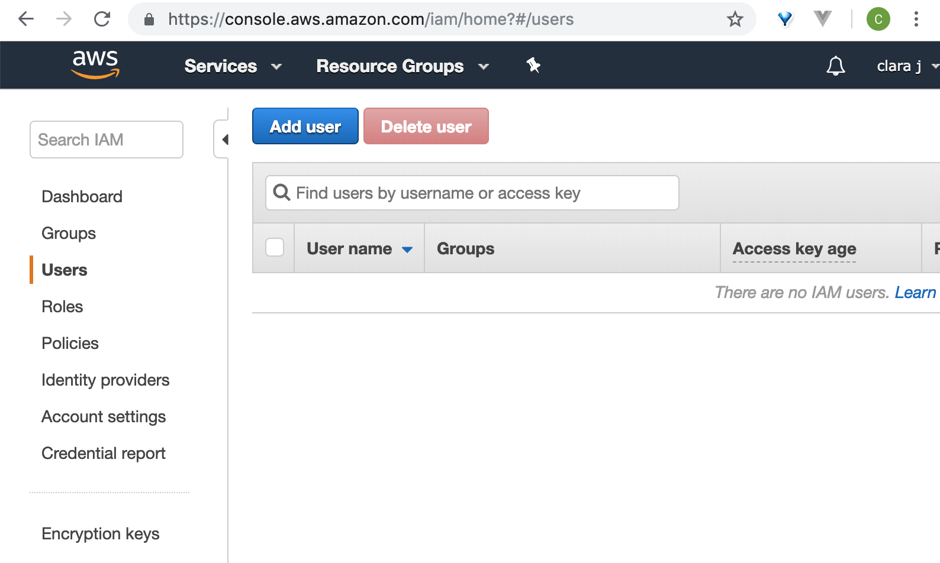
Create user
Click Add user

Slide 23
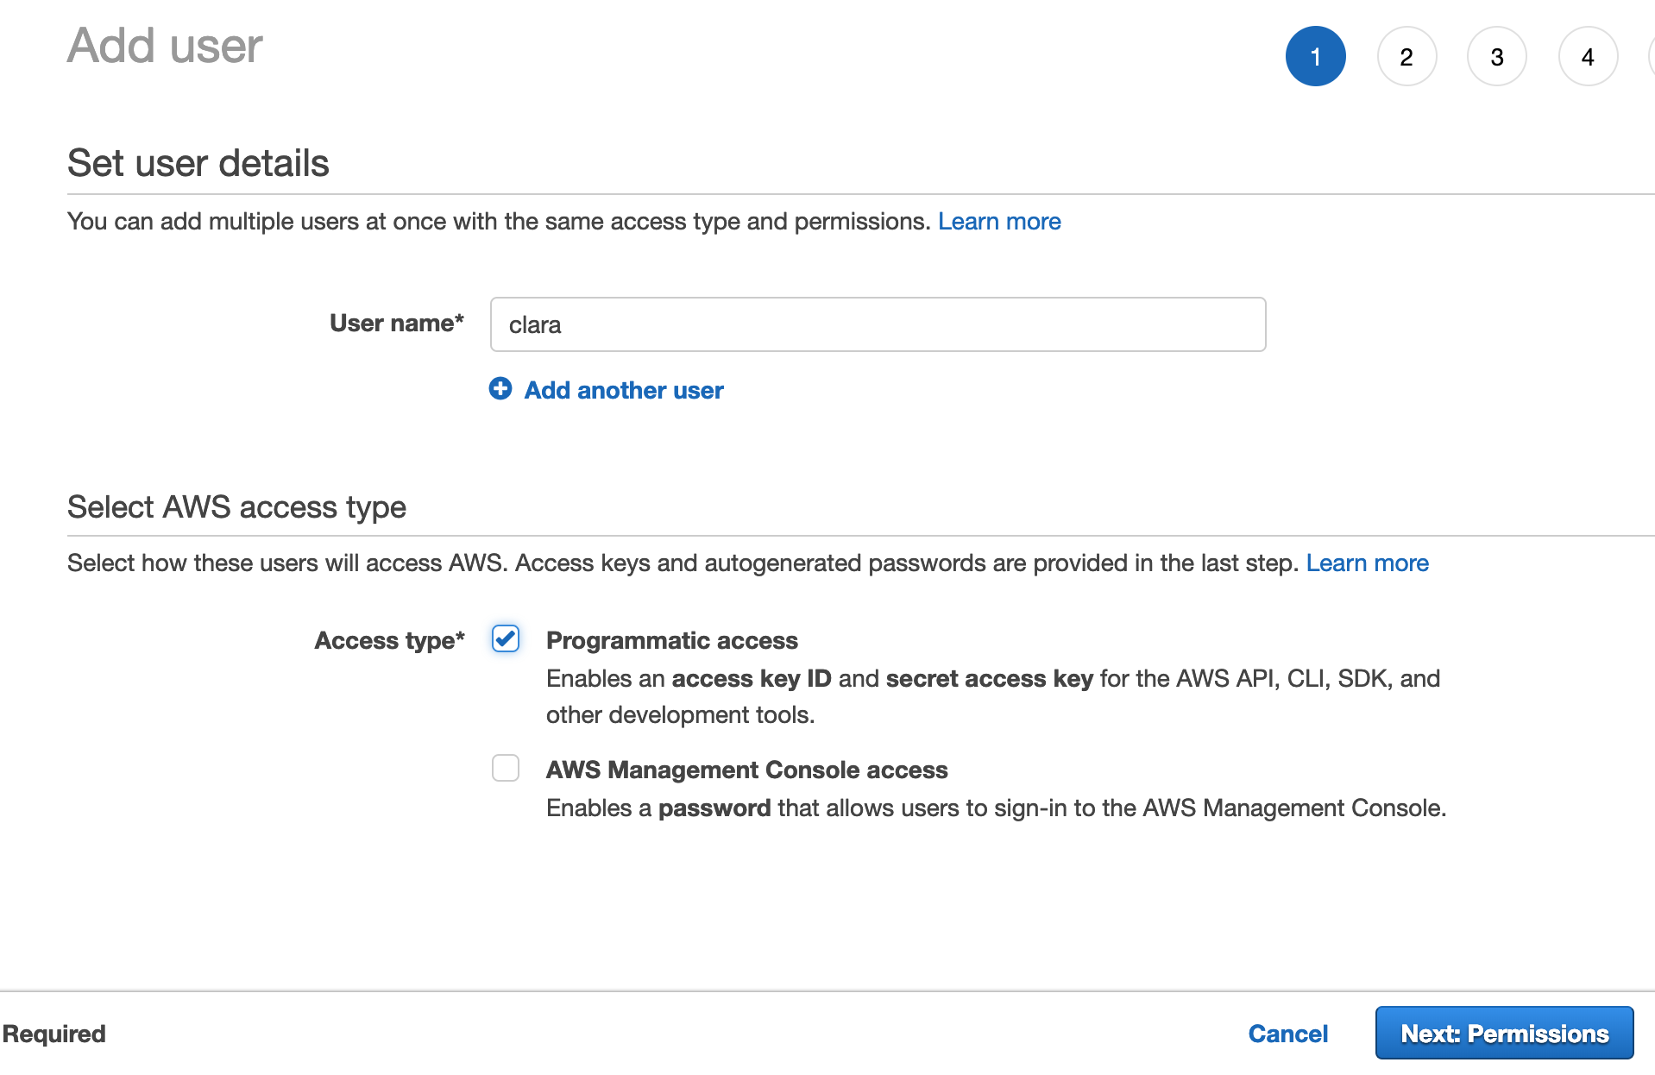
User Details
Provide a user name
Check the Programmatic access box

Slide 24
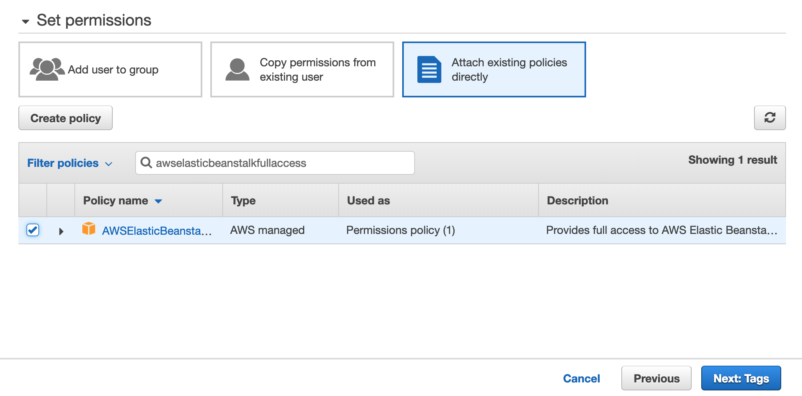
Add role
type awselasticbeanstalkfullaccess

Slide 25
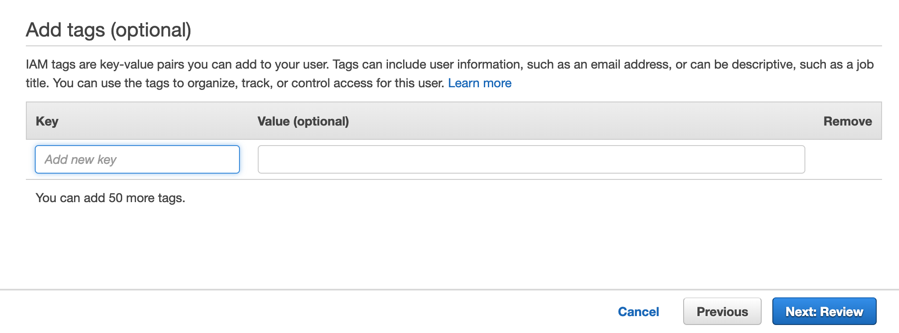
Add tags, review
No tags needed, click next

Slide 26
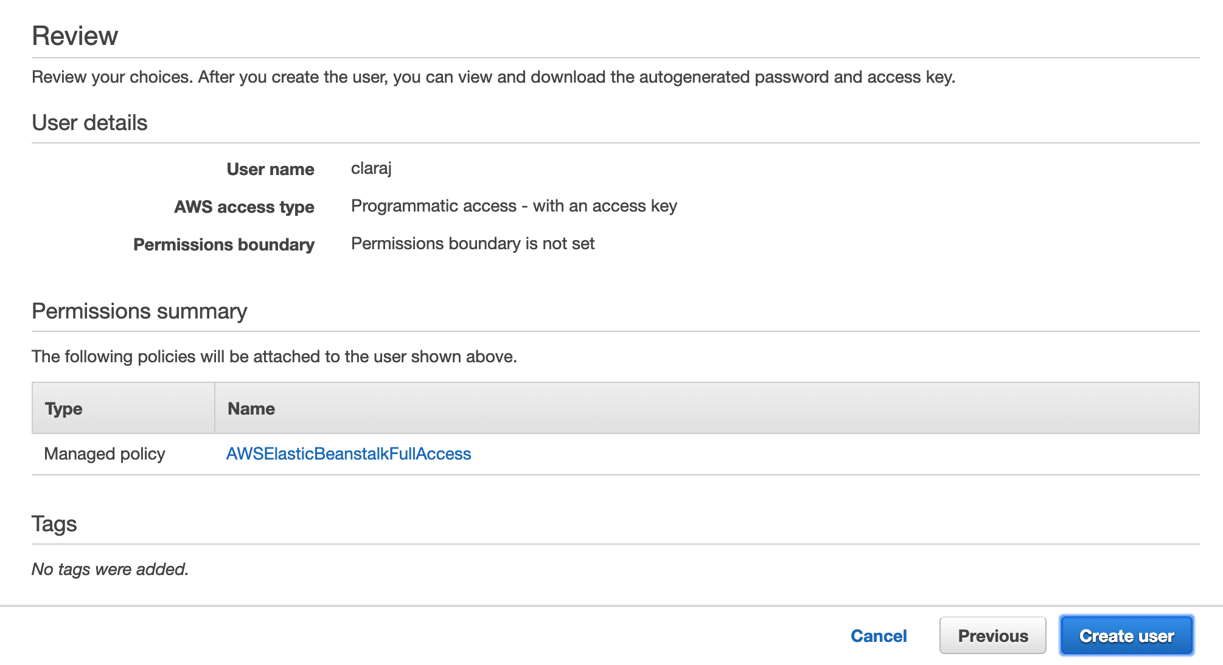
Review
Click Create User

Slide 27
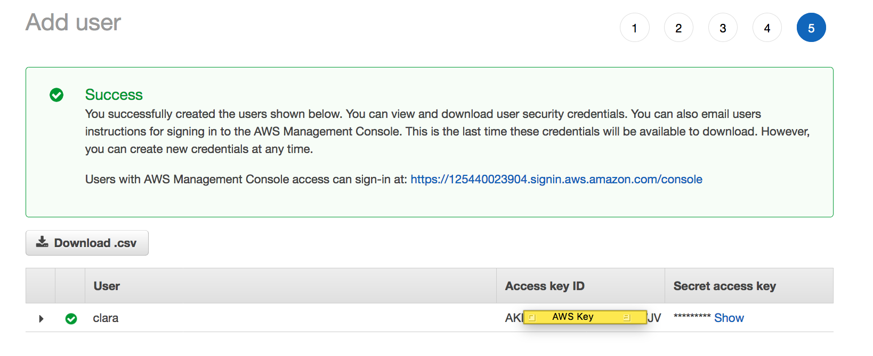
Credentials
Copy your Access key ID
Click to show your Secret access key
Make a copy of both. You won't be able to see them again
You'll need to delete this user and create another if you don't copy the keys

Slide 28
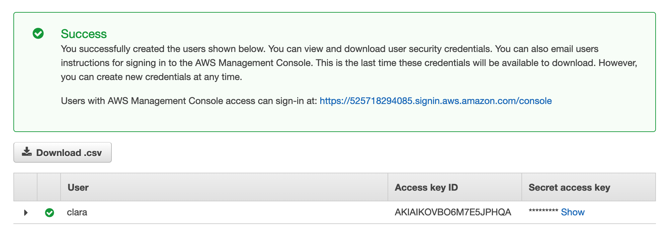
Download credentials
Download somewhere other than your project
Keep them safe
Don't put them on GitHub!

Slide 29
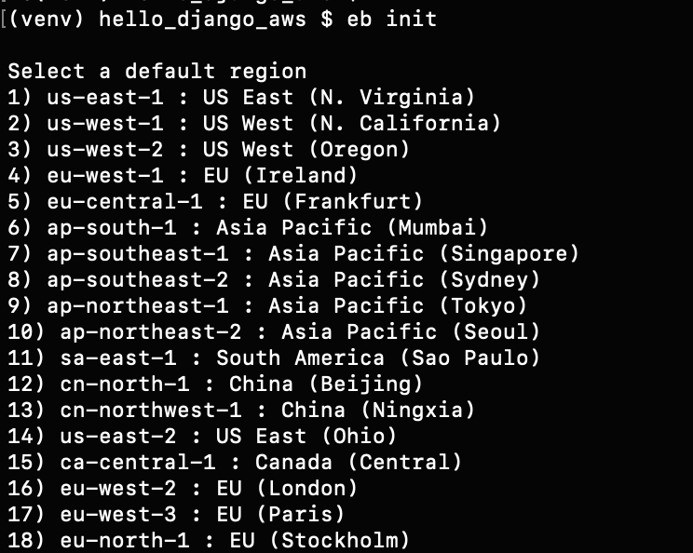
Create new Elastic Beanstalk application: eb init
From the root directory of your project (the hello_django_aws directory, same place as requirements.txt and manage.py) run this command to create a new AWS EB application
eb init
For the default region,
select us-east-1 (N.Virginia)

Slide 30
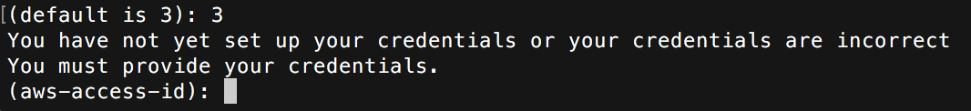
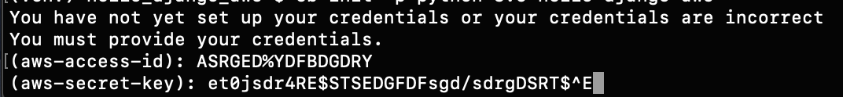
Credentials
This is NOT your username and password
Credentials required: this is an access key and secret access key (not your email and password)
Paste in the id and key you just created

Slide 31
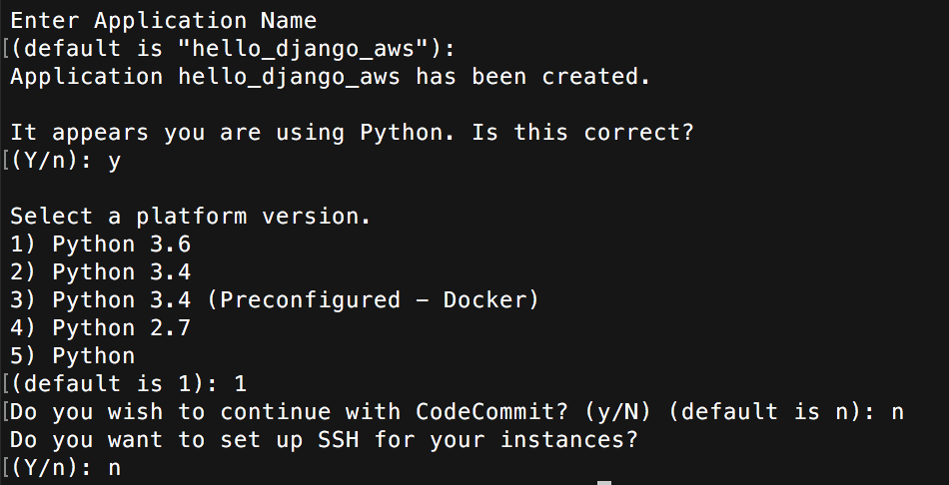
Create new Elastic Beanstalk application: eb init
Select create new application
Use default application name
Using Python: yes
Platform version: Python 3.6
Code Commit: no
SSH: no

Slide 32
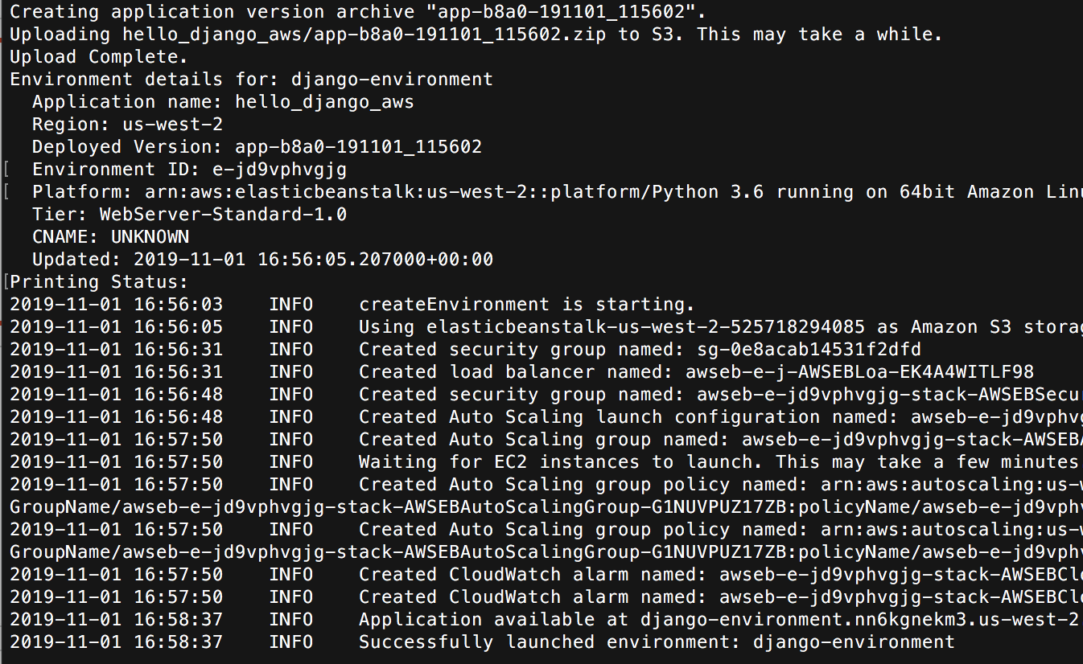
Create new instance
From the same directory as before
eb create django-environment
Files uploaded
Configuration
Can take a few
minutes
Verify no errors

Slide 33
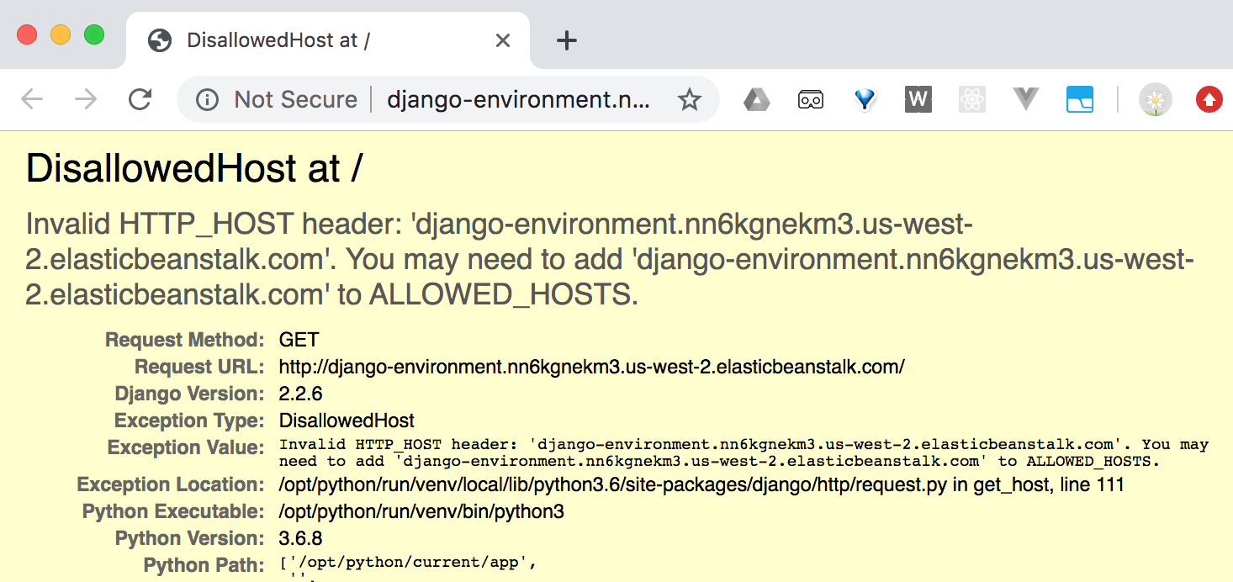
Open site
Type eb open to open site in browser
Or can open from web console
Is it working?
We need to do one more configuration step before our site is live

Slide 34
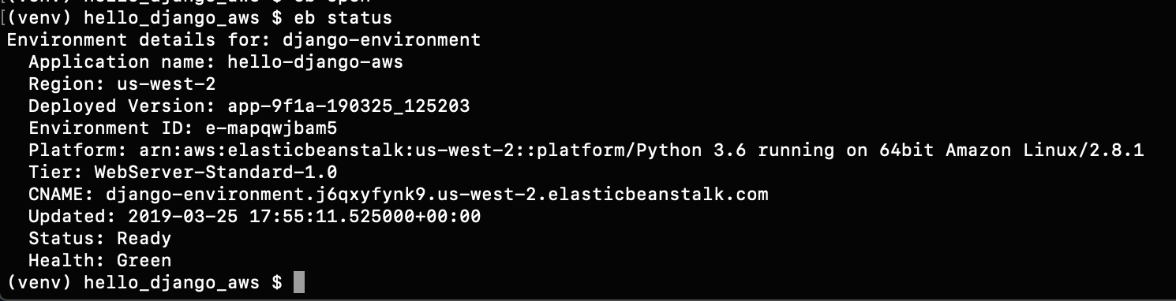
Django settings.py
Need to configure ALLOWED_HOSTS in settings.py
Copy the address of your site from your browser address bar
Or, in the terminal, run eb status
Look for the CNAME (canonical name) attribute

Slide 35
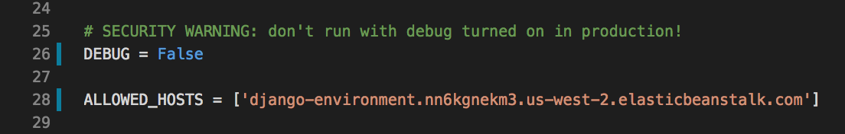
Copy the site name into string in allowed hosts
In your code, edit settings.py
Copy your own app name
Not there's no https:// in the address
Also set DEBUG = False

Slide 36
Add and commit changes Deploy
git add .
git commit -m "allowed hosts"
eb deploy
Wait… if success, use eb open to show your live site

Slide 37
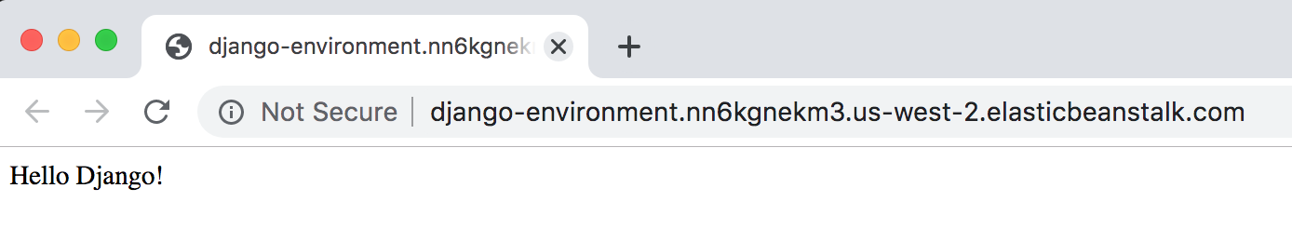
Live site
Should show the same Hello AWS! message

Slide 38
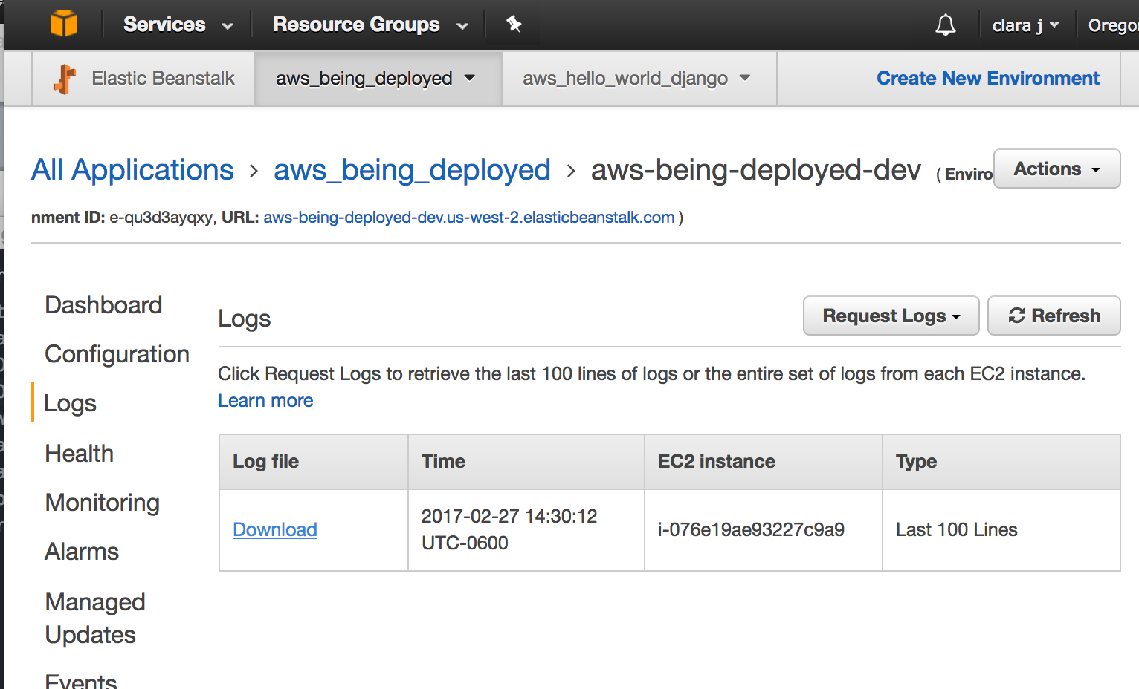
Errors?
Request logs

Slide 39
Errors?
Or type
eb logs
Press space to page through, q to quit

Slide 40
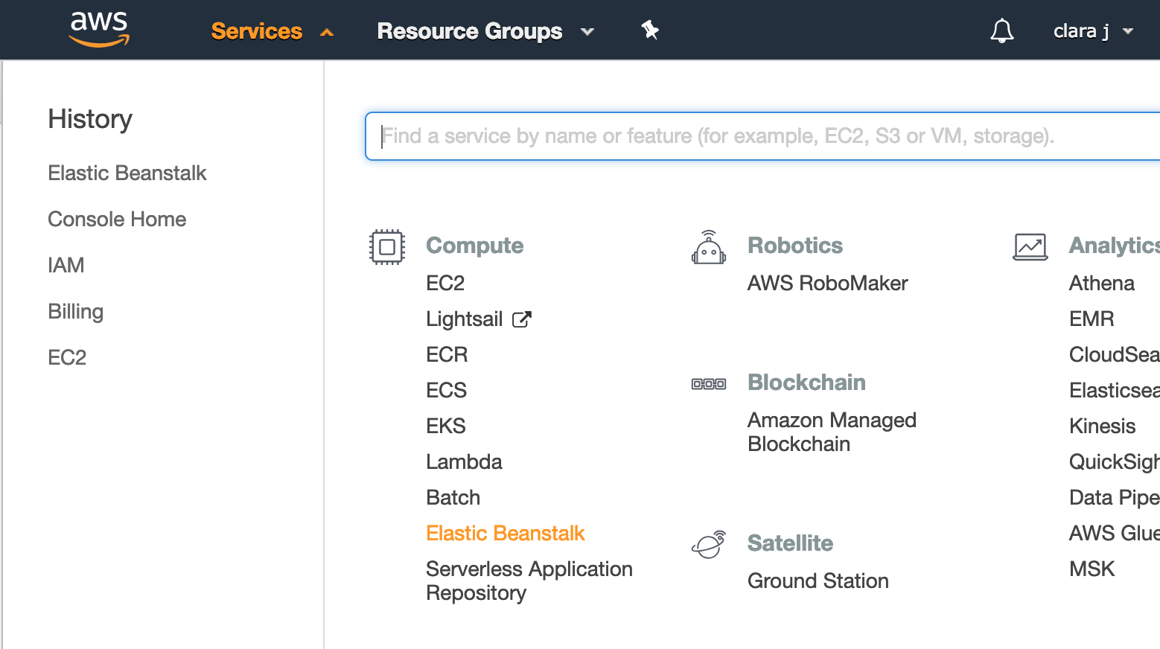
AWS Web Console
Click on Services, then select Elastic Beanstalk from the Compute section

Slide 41
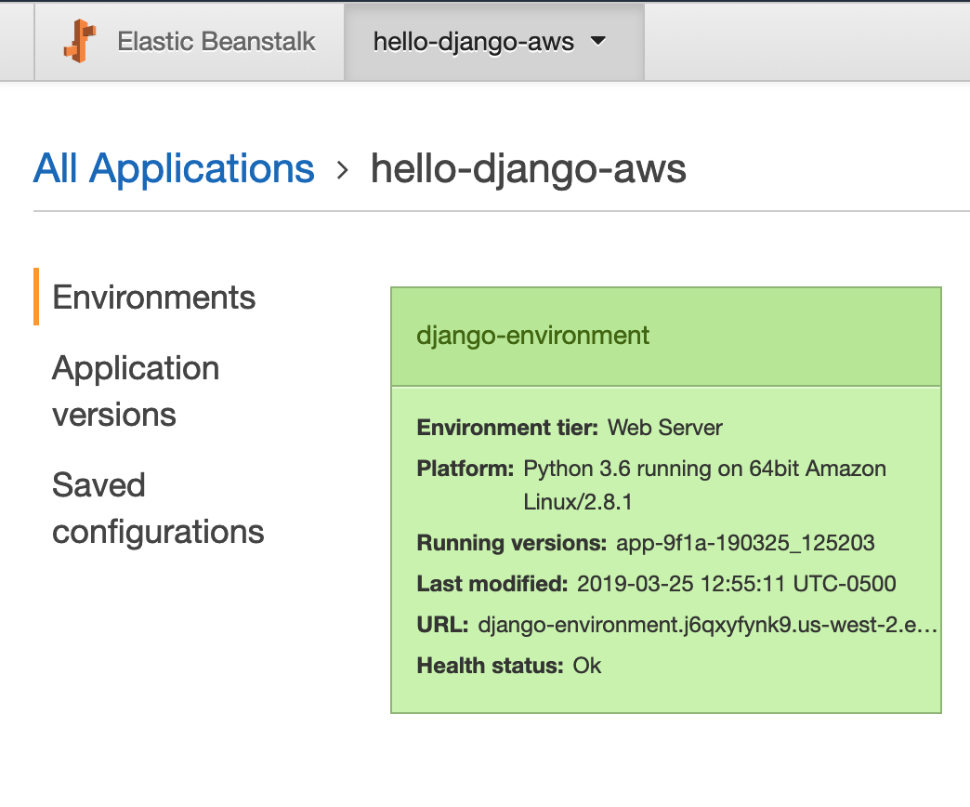
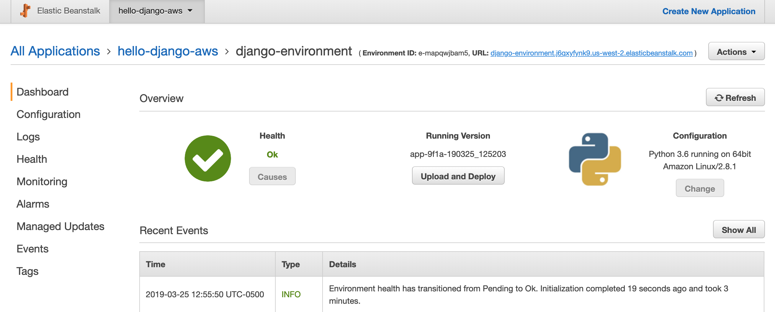
Elastic Beanstalk Console
Your site's URL

Slide 42
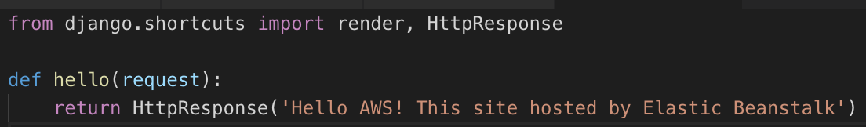
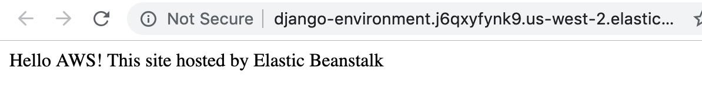
Modify site
Change the text returned by hello(request) in /hello_app/views.py to a new message of your choice
Use any message you like
Add changes, commit changes and deploy
eb deploy
Once deploy completed, check live site for update

Slide 43
Development once deployed…
Make changes
add modified files to git; commit
update any configuration files necessary
eb deploy
repeat as needed

Slide 44
eb commands
https://pypi.org/project/awsebcli/

Slide 45
Review
What's the difference between eb init command and eb create command?
What's an AWS application? What is an AWS environment?
What does eb create, create?
Why do you need to commit changes before pushing?
Why do you need create a user? Why not use main credentials?
Compare to Heroku, if you've used that

Slide 46
STOP
Demo your running Hello AWS app for credit for this part of the lab

Slide 47
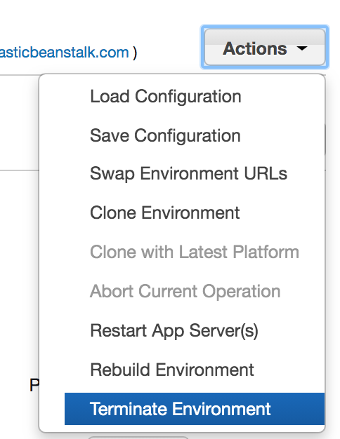
Cleanup
Once you have demonstrated your app, delete it by selecting Terminate Environment action from the Actions menu in EB console
Apps use resources and cost money just by existing, so delete apps you no longer need

Slide 48
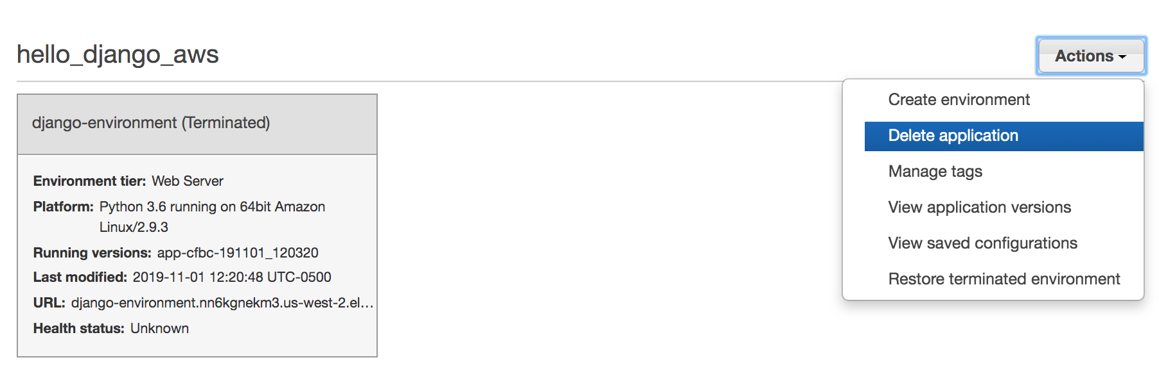
Cleanup - delete Application
From EB dashboard, Actions, Delete application

Slide 49
Deploy Travel Wish List
Use your code, the version with
File upload
Required login
Delete button
If you need a copy, https://github.com/claraj/wishlist_with_uploads

Slide 50
Travel Wishlist
Connects to a database
At the moment, sqlite3, for development
Will need to change to a client-server DB for deployment
Has CSS and JavaScript static files
These need to be stored somewhere
Users can upload files
These need to be stored somewhere too

Slide 51
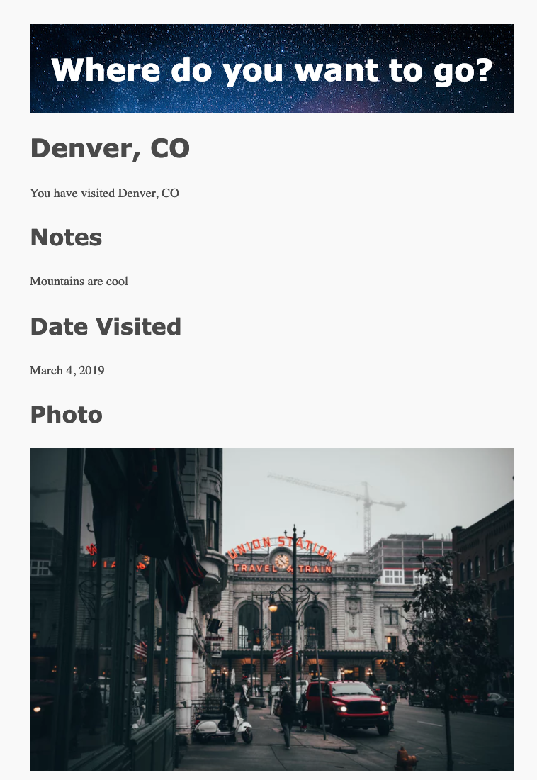
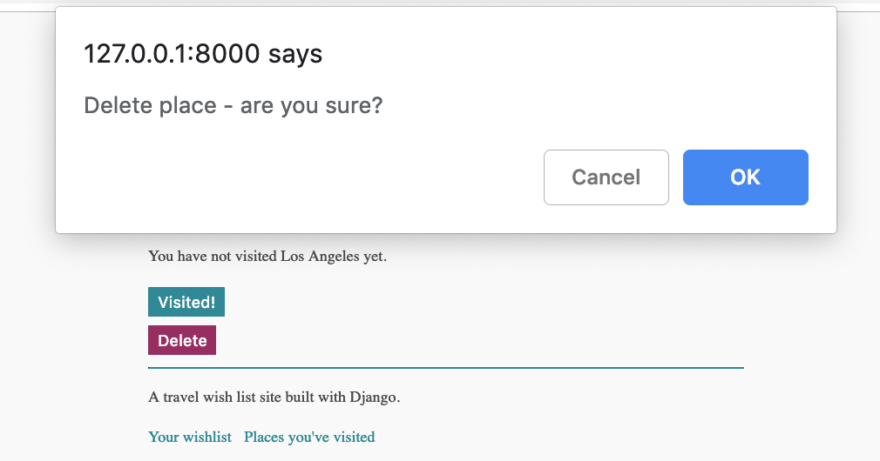
Features to be deployed
Click on a place name in wish list to see a message about that place
Click on a place in the visited list to be able to add date visited, notes, and upload a photo
Can delete visited and unvisited places
Client-side JavaScript for 'are you sure' message when deleting a place

Slide 52
Can Elastic Beanstalk Do Everything?
Elastic Beanstalk is for hosting web applications – its optimized for receiving requests, running application code, returning responses
It's not designed to store or serve static files
Since you pay per byte stored, EB is an expensive way to store data
Need two new services: RDS and S3

Slide 53
Relational Database Services, RDS
Hosted databases – SQLServer, PostgreSQL, SQLServer, Oracle... in the cloud
Optimized database servers
https://aws.amazon.com/rds/

Slide 54
Simple Storage Service, S3
Create storage areas called buckets
Optimized for file storage and retrieval, designed for serving files over HTTP
Much cheaper per byte of storage than EB, but can't run any app logic
https://aws.amazon.com/s3/

Slide 55
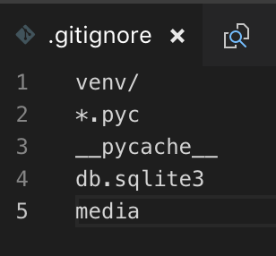
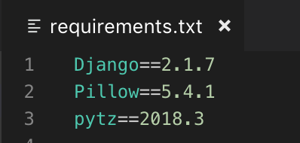
Verify initial configuration
Make sure you have a git repository for your project
Your .gitignore should have these entries ->
Add any IDE files like .idea or .vscode
Add and commit all of the other files
Make sure you have a requirements.txt in the root directory of your project

Slide 56
If using code from example
Migrate the database and create superuser
python manage.py migrate
python manage.py createsuperuser

Slide 57
Database
First, we'll replace Sqlite3 with PostgreSQL when app runs at AWS

Slide 58
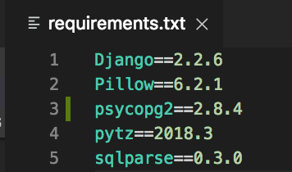
Add PostgreSQL driver dependency
pip install psycopg2
Add to requirements.txt
eb will use requirements.txt to install your app's dependencies, so make sure it's always up to date

Slide 59
Database config in settings.py
Currently, your app connects to a database on your computer
When it's deployed, it needs to connect to the RDS database
But it still needs to connect to a local database for development
Open wishlist/settings.py and modify the current database options to the following (next slide)

Slide 60
wishlist/settings.py for PostgreSQL
if 'RDS_DB_NAME' in os.environ:
DATABASES = {
'default': {
'ENGINE': 'django.db.backends.postgresql_psycopg2',
'NAME': os.environ['RDS_DB_NAME'],
'USER': os.environ['RDS_USERNAME'],
'PASSWORD': os.environ['RDS_PASSWORD'],
'HOST': os.environ['RDS_HOSTNAME'],
'PORT': os.environ['RDS_PORT'],
}
}
else:
DATABASES = {
'default': {
'ENGINE': 'django.db.backends.sqlite3',
'NAME': os.path.join(BASE_DIR, 'db.sqlite3'),
}
}
This checks the environment variables and if it seems to be running on AWS with RDS, use the first set of config options (which AWS & RDS will set up for you).
Otherwise, use the local settings.
Recommended: use a Postgres database for local development too, either an installed Postgres or an Elephant SQL instance

Slide 61
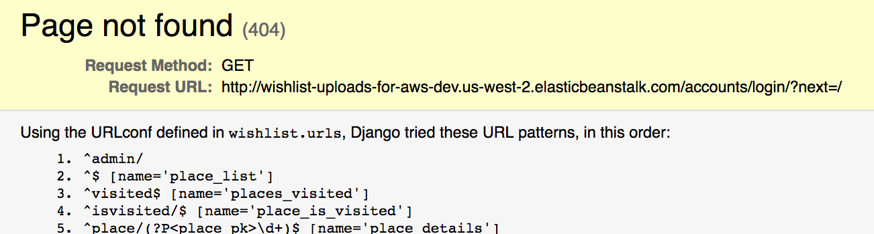
Reminder – Must Log In
Site at 127.0.0.1:8000, but that will show you an error
All of the routes require the user to be logged in, and the default is to redirect you to a sign-in page, which does not exist
Since this site be live online, and it permits image uploads, it would be a good idea to use access control
So go to 127.0.0.1:8000/admin and sign in with the superuser you just created
Now site should be accessible at at 127.0.0.1:8000

Slide 62
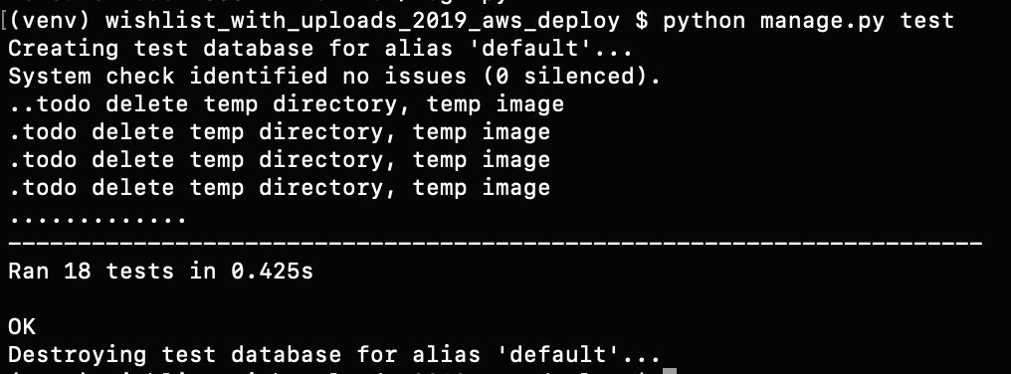
Everything still works?
Run app locally with python manage.py runserver
127.0.0.1:8000/admin
Verify can log in, site is still working
Run tests – should all still pass
python manage.py test

Slide 63
Postgres on AWS
Elastic Beanstalk (EB) is for running application code
EB is not designed for databases
What do database servers do? How is this different to web application servers?
How to deal with aackups? auditing? Using the data somewhere else?
You'll need to create and configure a database separately
We'll use a RDS (relational database service) database

Slide 64
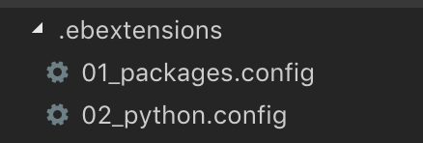
First, deploy app
In the root directory of your project, create a .ebextensions directory
Inside .ebextensions, create 01_package.config and 02_python.config
The names are important, EB will run the config files in name order.

Slide 65
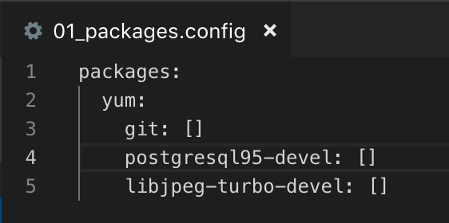
.ebextensions/01_package.config
Installing packages. Remember to use 2 spaces for each indent
This tells EB what to install when it starts running. AWS EB instances run Red Hat Linux, which uses a package manager called yum.
libjpg-turbo-devel is needed for Pillow, and Django needs Pillow for image uploads.

Slide 66
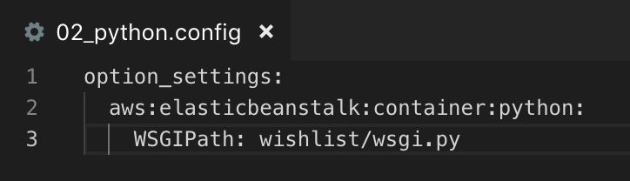
.ebextensions/02_python.config
Similar to previous
Replace wishlist/wsgi.py to your own path to wsgi.py, if different

Slide 67
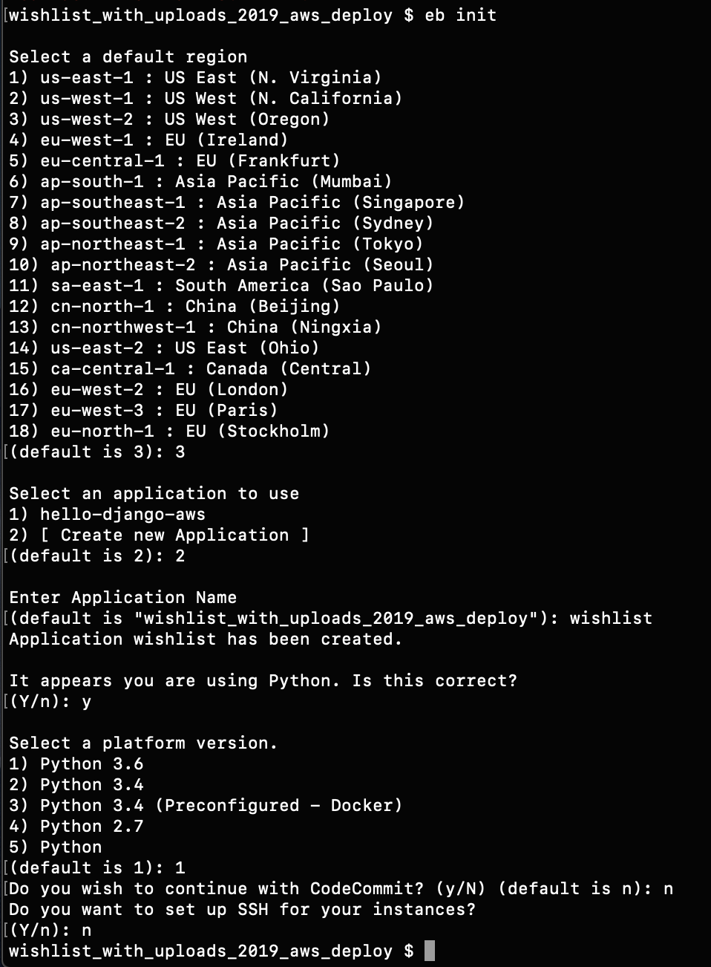
eb init
run eb init
region is us-east-1
[Create new application]
set application name or use default
Using Python? yes
Platform version Python 3.6
CodeCommit no
SSH no

Slide 68
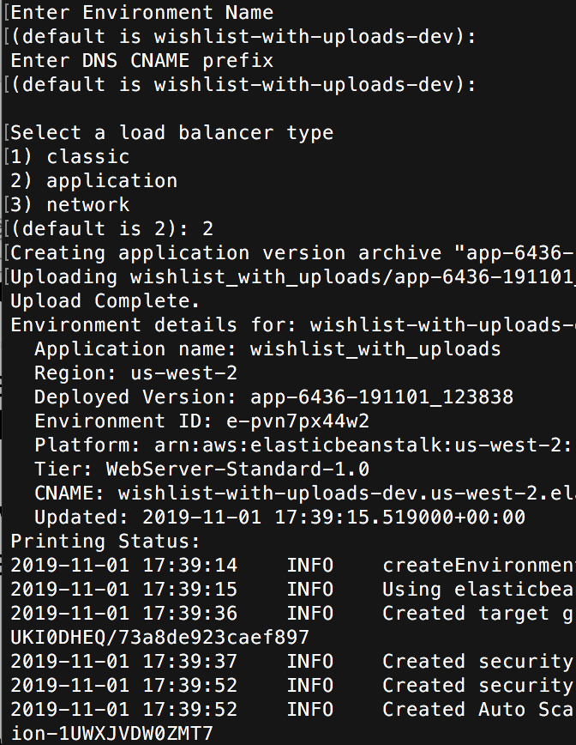
eb create
Run eb create
Environment name: press enter to use the default or enter your own name
DNS CNAME prefix: press enter to accept default
Load balancer: application
Wait… lots of output

Slide 69
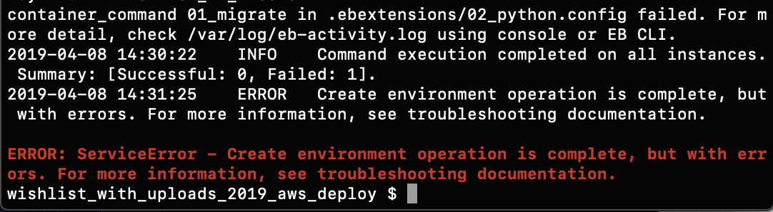
eb create error
WISHLIST_DB_PASSWORD not set

Slide 70
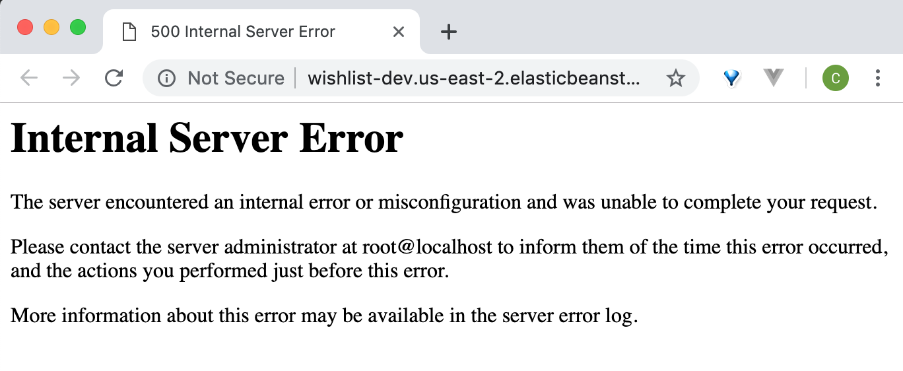
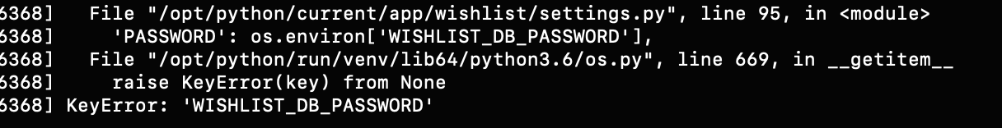
Open site
eb open
Another way to find out what's wrong
eb logs
At the end of /var/log/httpd/error_log…

Slide 71
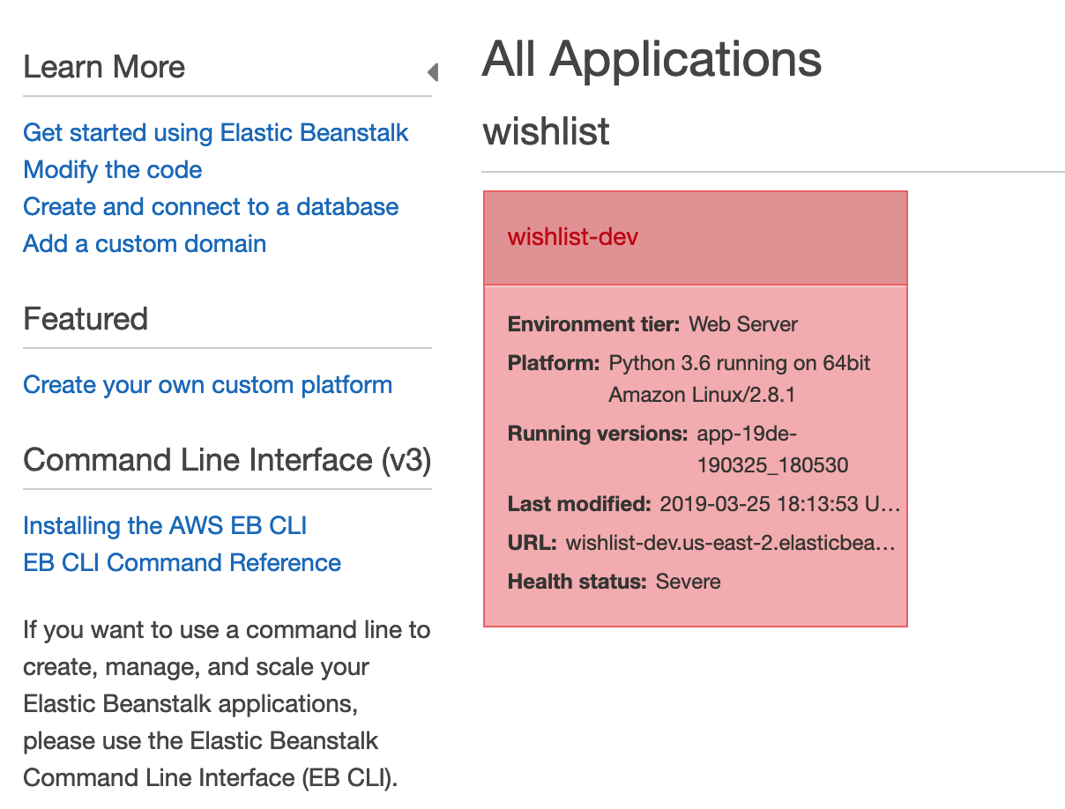
Set up database
Once your application and environment have been created, go to the EB console for your new Wish list application

Slide 72
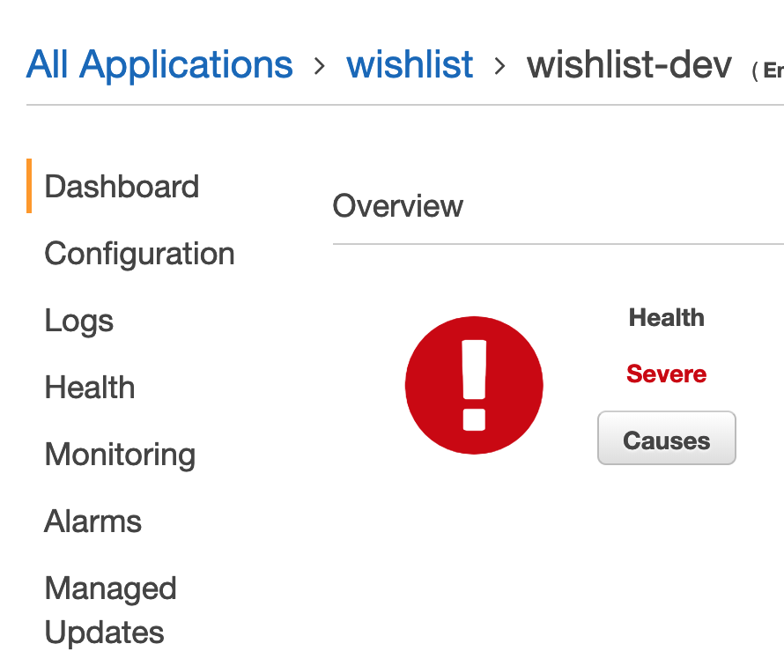

Application Configuration
Select your application
Click on Configuration in left menu bar
Scroll down to Database
Click on Modify

Slide 73

Configure RDS
DB engine is postgres
Engine version 11.5
Instance class db.t2.micro
Storage 5GB
DB username = traveler
Password = create a strong password
Retention delete
Availability: Low
Click Apply
Environment will update; database will be created…
You'll get an error if your password is not strong enough

Slide 74


Wait…
Updates, may take ~5 minutes
RDS database is created

Slide 75
Migrations?
The database created has no tables in it
To set up the database when the app starts, have to run migrations to turn the models in to database tables
Need to modify configuration files to tell AWS to do this before your app loads

Slide 76
Create superuser?
The user data is contained in a database, and you need to run the python manage.py createsuperuser command to create a superuser, which requires you to enter a username and password. That's tricky to write in a script
Django lets you create custom commands that can be passed to manage.py

Slide 77

.ebextensions/02_python.config
container_commands:
01_migrate:
command: "source /opt/python/run/venv/bin/activate && python wishlist/manage.py migrate --noinput"
leader_only: true
02_createsu:
command: "source /opt/python/run/venv/bin/activate && python wishlist/manage.py createsu"
leader_only: true
option_settings:
"aws:elasticbeanstalk:application:environment":
DJANGO_SETTINGS_MODULE: "wishlist.settings"
"PYTHONPATH": "/opt/python/current/app/wishlist:$PYTHONPATH"
aws:elasticbeanstalk:container:python:
WSGIPath: wishlist/wishlist/wsgi.py
Watch the indentation!
Use spaces, not tabs
This runs the database migration to create tables
Runs a custom script to create a superuser

Slide 78

Custom command to create superuser
In travel_wishlist directory (the one with models, fixtures, views…)
Create a directory called management
In management, create a directory called commands
In commands, create two files, __init__.py and createsu.py
__init__.py will be empty
createsu.py on the next slide

Slide 79

travel_wishlist/management/ commands/createsu.py
Replace with username, email, password
of your choice.
This will be your admin console password for your live site. Once your site is live online, you should log into the admin console of your travel wishlist app and change it to something more secure!

Slide 80
Try locally
python manage.py createsu
Should be no errors
Do you have a new admin user?
How can you check?
In your DB shell, select * from auth_users;
Try to log in to your site with username=admin, password=admin

Slide 81
Git add, commit, deploy
git add .
git commit -m "migrations and create super user"
eb deploy
Make sure your database has been created first, or this will probably error

Slide 82

Check site
eb open

Slide 83

wishlist/settings.py ALLOWED_HOSTS
In wishlist/settings.py
Change ALLOWED_HOSTS to your app's host name – find it from one of these places
The CNAME from eb status
The URL from the web console, without http://
The URL of your web page (eb open) without http://
For example – use your own app's URL

Slide 84
And deploy again
Add all new and modified files to git
Add and commit all changes
eb deploy
Wait… site should be live
If errors, review all previous steps
Can't fix? Ask for help!

Slide 85


Load your site
Should load with the same error message, as when running the site locally
Go to /admin
Which should bring you here – the same
administration site without CSS
Log in with the username and password
from your createsu.py script
Now change your
admin password
to a more secure
password!

Slide 86

Load your site
Site should also work, again without CSS
No background image behind the title
No JavaScript (try deleting a place)
Our CSS is missing (look at the form and buttons – the CSS we added put the buttons on the same line as the place
Why are the Sakura styles working?

Slide 87
Why no CSS?
CSS files are static files - always the same for everyone who visits your site
Versus pages generated by your application, which can be different for each user
It's best practice to serve static files from a regular web server
And serve your dynamic pages from a web application server
Takes advantage of the strengths of each type of server
The regular web server is cheaper to run - less computing power needed - so your site will be cheaper to host
On a platform like AWS, you effectively get charged by CPU cycle used; plus storage used

Slide 88
Django and Static Files
When you run your app locally with python manage.py runserver, a mini web server is started and it serves static files from a default location, usually yourproj/yourapp/static
https://docs.djangoproject.com/en/2.2/howto/static-files/
Fine for development, but not very efficient for production (see previous slide)
For this app, static files are stored in
wishlist/travel_wishlist/static/

Slide 89
Static files vs. application resources when deployed
Client – web browser
app.123.elasticbeanstalk.com/place/9
Give me the page for place 9
AWS Services
Sakura CDN
Elastic Beanstalk
Now to display the page
Here's the HTML page
It's got links to some static resources
RDS
There's a CSS link, request this
And another CSS link
And a site image link
And a user image link
And a JavaScript link
....
I need to talk to the database to get the data to make this page
Bucket: app static files
Bucket: user uploads static files

Slide 90
Difference between serving static files and application responses (HTML pages)
Browser requests page from Elastic Beanstalk
Elastic Beanstalk talks to RDS, generates response - typically HTML page with links to any static resources
The static resource href/src links point to the storage buckets (in Sakura's case, the Sakura CDN)
When browser receives HTML response page, it reads the HTML and starts displaying the page in the user's browser
As the browser finds links to static resources, it makes another request for each static resources
These links point to S3 buckets, so requests for images. CSS etc. are made to the S3 buckets (and for this app, Sakura)
The client can then display the complete page
Elastic Beanstalk app only provides the appropriate link, it doesn't serve the resource

Slide 91

Static files: Simple Storage Service, S3
In your AWS console, search for S3

Slide 92

Static files: Simple Storage Service, S3
Click Create Bucket
Give your bucket a name – I called mine wishlist-dev-static
but you'll need to use another name
Region US EAST 1

Slide 93

Properties
All defaults are good
Don't check anything, no tags
Click Next

Slide 94

Set Permissions
Uncheck all the boxes*
Click Next
Click Create Bucket
For a real app, you'd implement access control to only allow the Wishlist application
to write to the bucket.

Slide 95

New Bucket
You may have another bucket - what's in it?

Slide 96
Create new user to manage this bucket
In general, for security reasons, you want to divide responsibilities, instead of giving everyone access to everything
At a company, someone would own the AWS account, and then within that account, create user accounts, and assign each account relevant permissions. Everyone would have their own access credentials; roles; permissions

Slide 97

Create new user with IAM
Search for IAM
Identity and Access Management
Used for creating users, giving them roles and permissions

Slide 98

IAM - Create new user
Click Users in side menu
Click Add user button
Give your user a name, and check the Programmatic access checkbox
Uncheck AWS management console access
Click Next

Slide 99

Permissions
Attach existing policies directly, search for S3, check AmazonS3FullAccess, Click Next

Slide 100

No tags, click Next: Review
Then click Create user

Slide 101
User Created
The next screen should show you an Access key ID, and a link to show the Secret access key
You'll download these to your computer
You won't be able to download them again; but if you lose them (or put them on GitHub by mistake) you can revoke and regenerate new keys

Slide 102

Download
Download keys, or show the secret access key and make a note of it
As before, you can't see the secret key after you navigate away from this page

Slide 103

Get new user's ARN
Close the page with the keys
Click on the new user's name
Make a copy of the User ARN (Amazon Resource Number)

Slide 104

Back to your S3 bucket
Click on the Permissions tab
Select Bucket Policy
Bucket policy editor – next slide

Slide 105
Bucket policy statement Replace BUCKET-NAME with your bucket's name (3 times) Replace BUCKET-USER-ARN with your new S3 bucket user's ARN Click Save
{
"Version": "2012-10-17",
"Id": "WishlistBucketPolicy",
"Statement": [
{
"Sid": "PutObjects",
"Effect": "Allow",
"Principal": {
"AWS": "BUCKET-USER-ARN"
},
"Action": "*",
"Resource": [
"arn:aws:s3:::BUCKET-NAME",
"arn:aws:s3:::BUCKET-NAME/*"
]
},
{
"Sid": "PublicReadAccess",
"Effect": "Allow",
"Principal": "*",
"Action": "s3:GetObject",
"Resource": "arn:aws:s3:::BUCKET-NAME/*"
}
]
}

Slide 106

Install packages (locally)
pip install django-storages
(storages with a S at the end)
pip install boto3
Add these new requirements to your requirements.txt
https://django-storages.readthedocs.io/en/latest/backends/amazon-S3.html

Slide 107

Install packages (locally)
Open wishlist/wishlist/settings.py and add 'storages' to the end of
the INSTALLED_APPS list
https://django-storages.readthedocs.io/en/latest/backends/amazon-S3.html

Slide 108

Elastic Beanstalk Console
In your app, click on Configuration
Find Software and click on Modify

Slide 109

Scroll down to Environment Properties
Can set environment variables here

Slide 110

Elastic Beanstalk Console
Environment Properties: add two new properties
Use the bucket user's credentials that you downloaded after creating the user
Name = AWS_ACCESS_KEY_ID Value = your S3 user's Access Key
Name = AWS_SECRET_ACCESS_KEY Value = your S3 user's secret access key
Click Apply

Slide 111
settings.py
Add to the end
replace your-bucket-name with your S3 bucket name
STATICFILES_LOCATION = 'static'
MEDIAFILES_LOCATION = 'media'
#If we are on AWS...
if 'RDS_DB_NAME' in os.environ:
AWS_STORAGE_BUCKET_NAME = 'your-bucket-name'
AWS_ACCESS_KEY_ID = os.getenv('AWS_ACCESS_KEY_ID')
AWS_SECRET_ACCESS_KEY = os.getenv('AWS_SECRET_ACCESS_KEY')
STATIC_URL = f'https://{AWS_STORAGE_BUCKET_NAME}.s3.amazonaws.com/{STATICFILES_LOCATION}/'
MEDIA_URL = f'https://{AWS_STORAGE_BUCKET_NAME}.s3.amazonaws.com/{MEDIAFILES_LOCATION}/'
STATICFILES_STORAGE = 'storages.backends.s3boto3.S3Boto3Storage'
DEFAULT_FILE_STORAGE = 'storages.backends.s3boto3.S3Boto3Storage'

Slide 112

.ebextensions/02_python.config
Collect static files
django_storages and boto will handle moving them to the S3 bucket for the app to use

Slide 113
Commit changes and deploy
git add .
git commit -m "Static files"
eb deploy

Slide 114


Check site
Background image
Our CSS and JS should start working
Upload images should work
Our JavaScript, are you sure message when deleting a place
Check for red delete button

Slide 115

Check your S3 Bucket
Directories for your static files
Directory for user_images

Slide 116
Run collectstatic locally
python manage.py collectstatic
Type yes
Several files (CSS, JS for your site, and for the admin console) will be copied to new www directory
Now both the local and deployed versions should have the static files in the equivalent location

Slide 117

Final modifications to settings.py
Change DEBUG to default to False
After you set up the static files, your static files won't work locally unless you set DJANGO_DEBUG=1
Now you will need to run
set DJANGO_DEBUG=1 (PCs)
export DJANGO_DEBUG=1 (Mac or Linux)
to run in debug mode, else production mode

Slide 118

Last Modification - Secret Key
We should replace secret key with a new, random key
Generate a new key using this script https://gist.github.com/ndarville/3452907
Save as an environment variable DJANGO_SECRET_KEY locally, and in your EB configuration > Software > Environment Properties

Slide 119
Last Modification - Secret Key
Modify settings.py to read key from environment variable

Slide 120
Deploy again
git add
git commit -m "secret key"
eb deploy
Verify everything is still working
The local and deployed versions should both work
Try a page that doesn't exist at AWS – should see generic 404 message

Slide 121
Separate Media and Static Files
Improvement: better to have two buckets, one for media, one for static files
Media: things your users might upload; profile pictures, pictures for social media sites, travel report pictures…
Static files: things that you create for your site, CSS, JavaScripts, your logos, backgrounds, other images...
Serving separately allows you to manage them more easily
Example: you may want to delete all of the files uploaded by a user who closed their account without risking deleting any files that belong to your site

Slide 122
CDN
Why could it be a bad idea to making everything in your bucket public?
Open to abuse – you pay per file downloaded/uploaded
Recommended: set up AWS CloudFlare CDN as intermediary between the internet and your bucket
CDN will cache files and serve from cache
Can detect and block excessive file access

Slide 123
Different settings.py files for different environments
The settings.py has a lot of if statements to check if the code is running locally vs. AWS
Better: two settings.py files, load one if deployed, load the other if local
https://docs.djangoproject.com/en/2.2/topics/settings/
https://simpleisbetterthancomplex.com/tips/2017/07/03/django-tip-20-working-with-multiple-settings-modules.html

Slide 124
Deployed version
https://github.com/claraj/wishlist_with_uploads_aws

Slide 125

Production mode
If DEBUG=False, no debug information leaked errors; generic 404 page
Make sure you set the DJANGO_DEBUG=1 environment variable when running on your computer; debug mode needed to serve static files correctly with manage.py runserver; also for stack traces for errors

Slide 126
Checklist
App runs when deployed
Generic 404 page
User can upload images, images are saved
User images stored in /user_images directory of bucket
Static files served from bucket
Site has background image behind site name, JavaScript, our CSS

Slide 127
Production
Code goes through at least two stages; development and production; and usually one or more others; names may vary
Development environment: on your machine, as it's being worked on; code changing quickly as you work; optimized for restarting; changing config; viewing error messages and troubleshooting
Testing environment: similar to dev environment; but with code will not change as often; updated with used for internal QA testers
Staging environment: similar to production, may use test or real data; may be available to selected customers. For more testing, and checking if the code is ready to move to…
Production environment: the real world, app is released; is live; online; public; in the app store…
https://en.wikipedia.org/wiki/Deployment_environment

Slide 128
Development vs. Production
AKA dev vs prod
The environment where the code is being developed is not the same as the place where it will run
So what works in development may not work as expected in production
And you've got to build code with consideration to how it will be deployed

Slide 129
Development vs. Production
The development code and configuration is optimized for development, and is different to production code optimized for running for the customer
Different web server - python manage.py runserver runs a very basic web server. For production, you'll want a real web server that can be configured, handle real demand, write logs, and do it all quickly and securely. Also, you'll want to serve static files separately from web app-generated pages; as we did with EB and S3
Different database; DB on your machine vs. different server
Using test data vs. real data
Optimized, faster code
Different log levels; debugging output
Removing any private/proprietary data; different keys/secrets for dev vs. prod
Code cleanup
Production is online and handling real web traffic. Network, firewall issues
Running on your machine vs. running on servers - server can run different OS and have hardware (memory, storage…)
(for compiled code) different build for production (optimize for speed) vs. development (optimize for running with a debugger)
Different strategies for dealing with errors
Few or one user vs. many real, live users
Many other concerns…..

Slide 130
But it works on my computer…
A common response to facing a bug in production: 'but it works on my machine!' *
"I don't care if it works on your machine! We are not shipping your machine!" -- Ovidiu Platon
* This is not a good excuse https://blog.codinghorror.com/the-works-on-my-machine-certification-program/

Slide 131
How does this apply to LMN?
LMN needs to be deployed to AWS
Heroku, Azure, or Google Cloud Platform are alternatives if desired
Heroku does support Postgres databases but does not have an equivalent of S3 for storage - you'll need to create a S3 bucket or similar for Heroku to use

Slide 132

Billing
WATCH YOUR BILLING ACCOUNT
Use the reports to you can see what you are using, and what it is costing
Shut down/disable services you don't need - remember a database or a bucket will still incur charges for existing, even if it is disabled
Recommended: set up a budget which can send email alerts to notify you if you've spent a certain amount

Slide 133
References
https://realpython.com/blog/python/deploying-a-django-app-and-postgresql-to-aws-elastic-beanstalk/
https://www.caktusgroup.com/blog/2014/11/10/Using-Amazon-S3-to-store-your-Django-sites-static-and-media-files/

Slide 134
Finishing Up, Lab, and Cleanup
Please show me your app running for credit for this lab
If you haven't got everything working, finish up and submit the link to your live site to the Lab dropbox
Once I've verified everything is working, you may delete this project to avoid being billed
You'll need to delete all of the resources:
EB environment and application
RDS database
Both S3 buckets

Slide 135
Further Reading : Containers
You've deployed an app to a VM running on Amazon; then configured DB, storage
For a larger app, there may be more configuration needed
Another way to deal with deployment: containers
Package your app, dependencies, configuration… in a container. Once done, deploy the container.
The idea is to have more consistency between development and production environment
Examples: Docker, Kubernetes
https://www.docker.com/
https://kubernetes.io/
https://techcrunch.com/2016/10/16/wtf-is-a-container/

